Slide 1
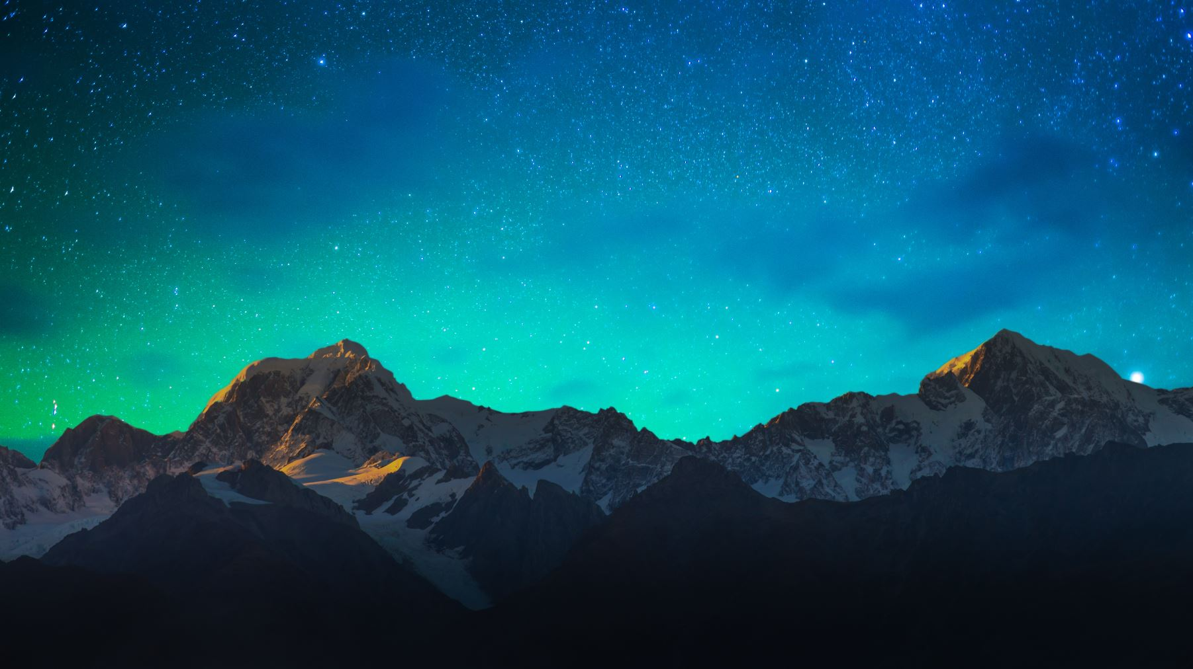
Dark Skies
Friendly lighting for neighbors and biodiversity

Slide 2
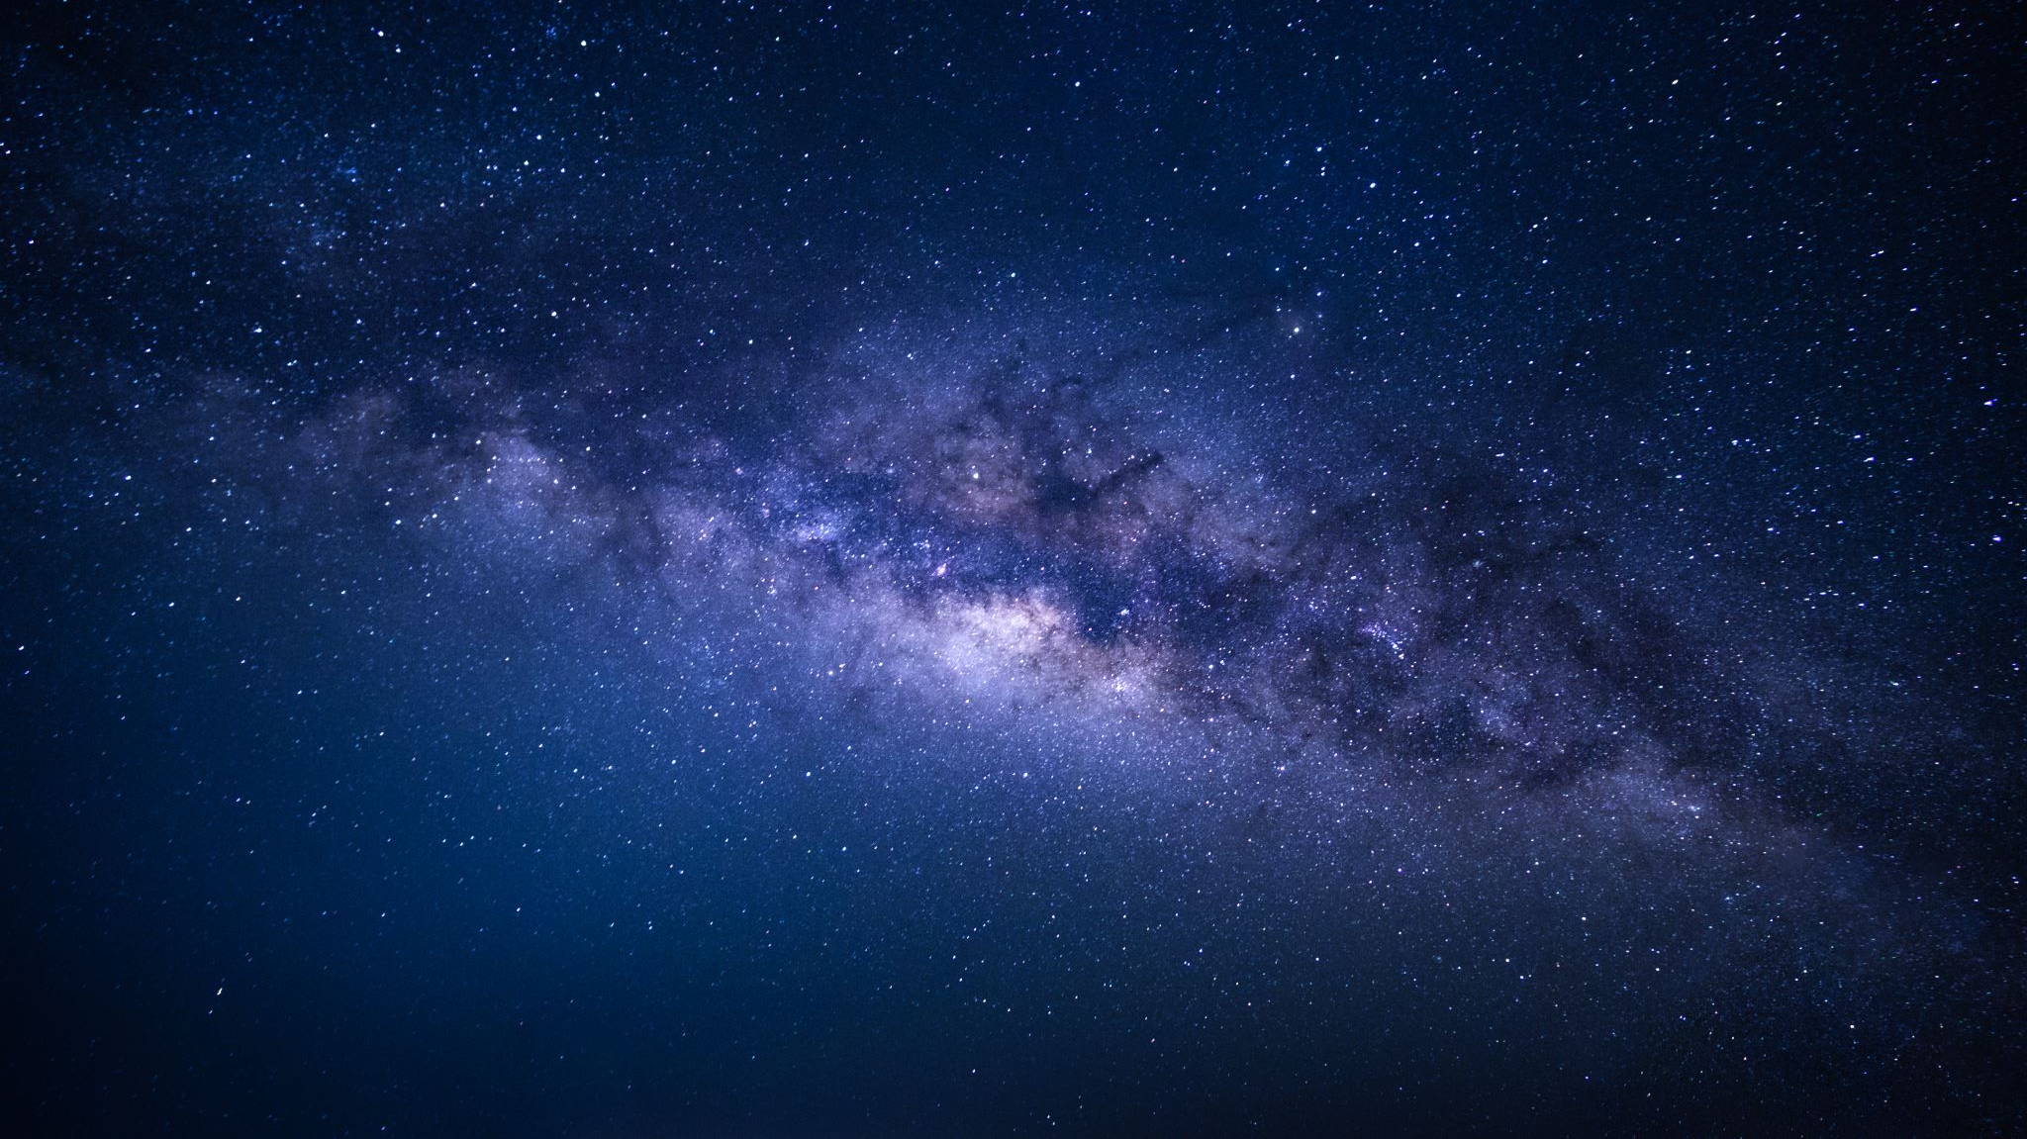
Why Dark Skies?
Seeing the stars at night is part of the natural beauty that makes country dwellers so fortunate
Scientists recognize that uninterrupted periods of dark are critical for human health
Animals, birds and insects rely on a clear demarcation between night and day
Reference: https://www.scientificamerican.com/article/the-sky-needs-its-silent-spring-moment/
Notes:
Protection of Rural Character and Scenic Resources is one of the key comprehensive plan highlights
Our circadian rhythms are timed to periods of light and dark. When these timing cues are absent people suffer from insomnia, depression and a host of other health issues.
I drove out to a cattle farm in rural North Carolina to meet Murry Burgess, a graduate student at North Carolina State University who had strung up little Christmas lights over swallow nests built in the rafters of a barn. She went up on a ladder, pulled out what looked like squirmy, stubble-feathered dinosaurs one by one, and subjected each chick to a battery of tests while clutching it gently in her warm palms. The parents didn't know to move their nests away from the lights, she said, and the light took a toll on their babies' bodies. Compared with neighboring chicks growing up under no lights, coming of age under just one tiny bulb had made these birds stunted and underweight.
Campaigns to turn off lights during bird migration season are spreading all over the country; in Texas cities such as Dallas and Houston, for example, more than 100 downtown buildings dimmed their lights this past spring.

Slide 3
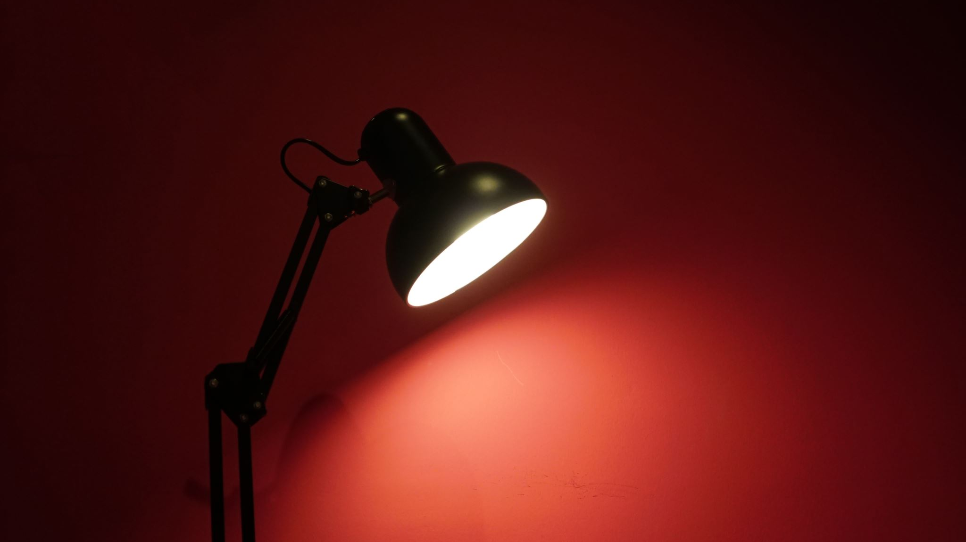
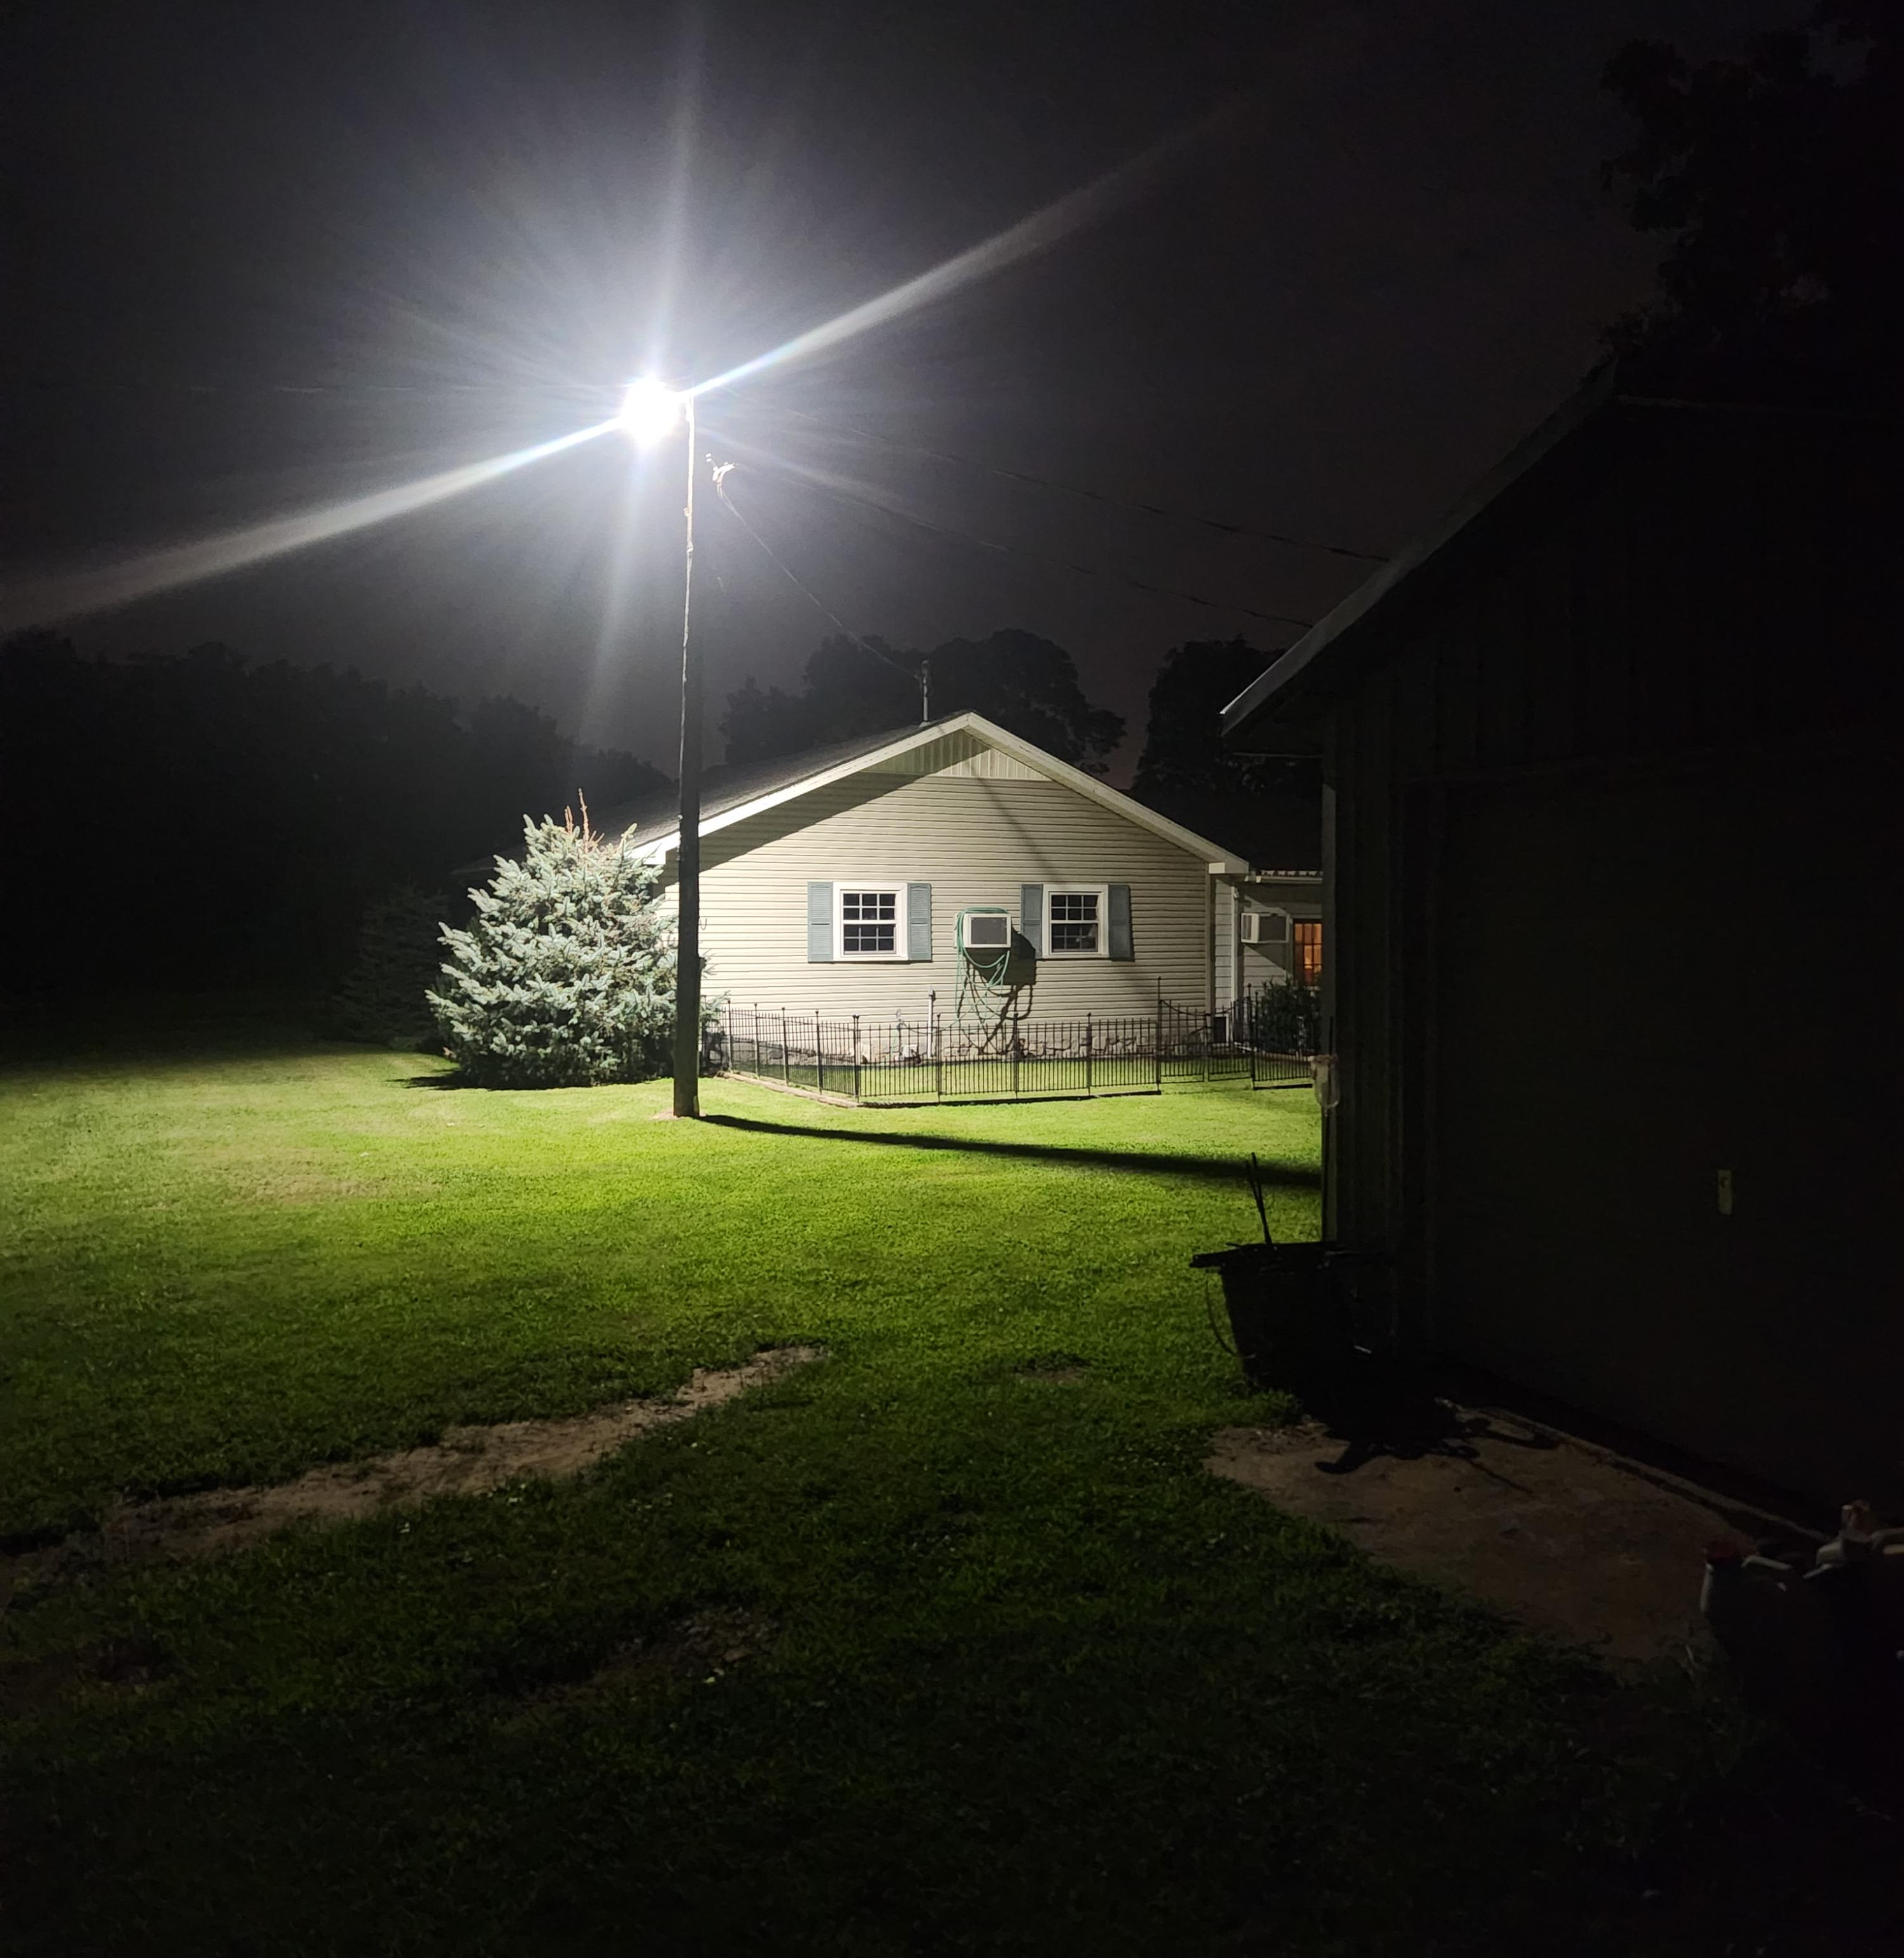
Lighting for safety
More light is not the same thing as “more safe”
Glare reduces night vision acuity
Human vision is not designed for “high contrast”
Light the ground, not the world
Tall lighting poles and unshielded bulbs cause glare
More light is NOT “more safe”

Slide 4
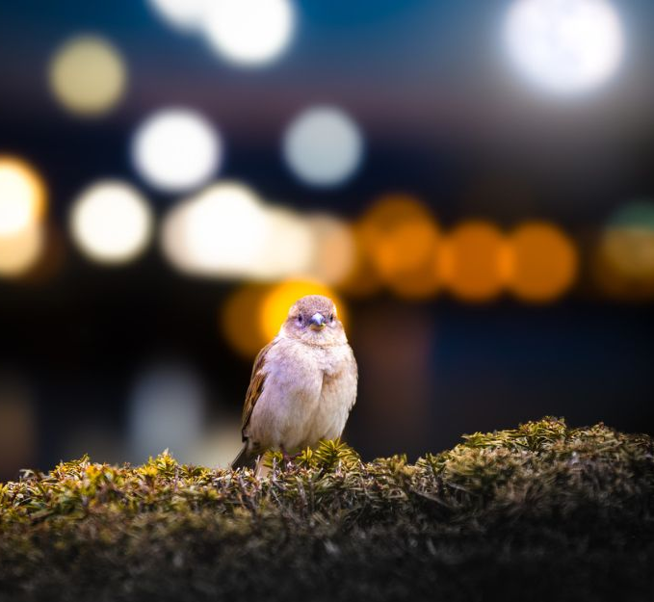
Lighting for biodiversity
Dark skies are essential for maintaining the intricate web of life that connects all living organisms in an ecosystem
Altered light patterns can disrupt the natural predator-prey dynamics, leading to imbalances in populations
Many bird species rely on the stars for navigation. Light pollution disorients them, causing them to lose their way and potentially perish
Creatures need NATURE’S lighting

Slide 5
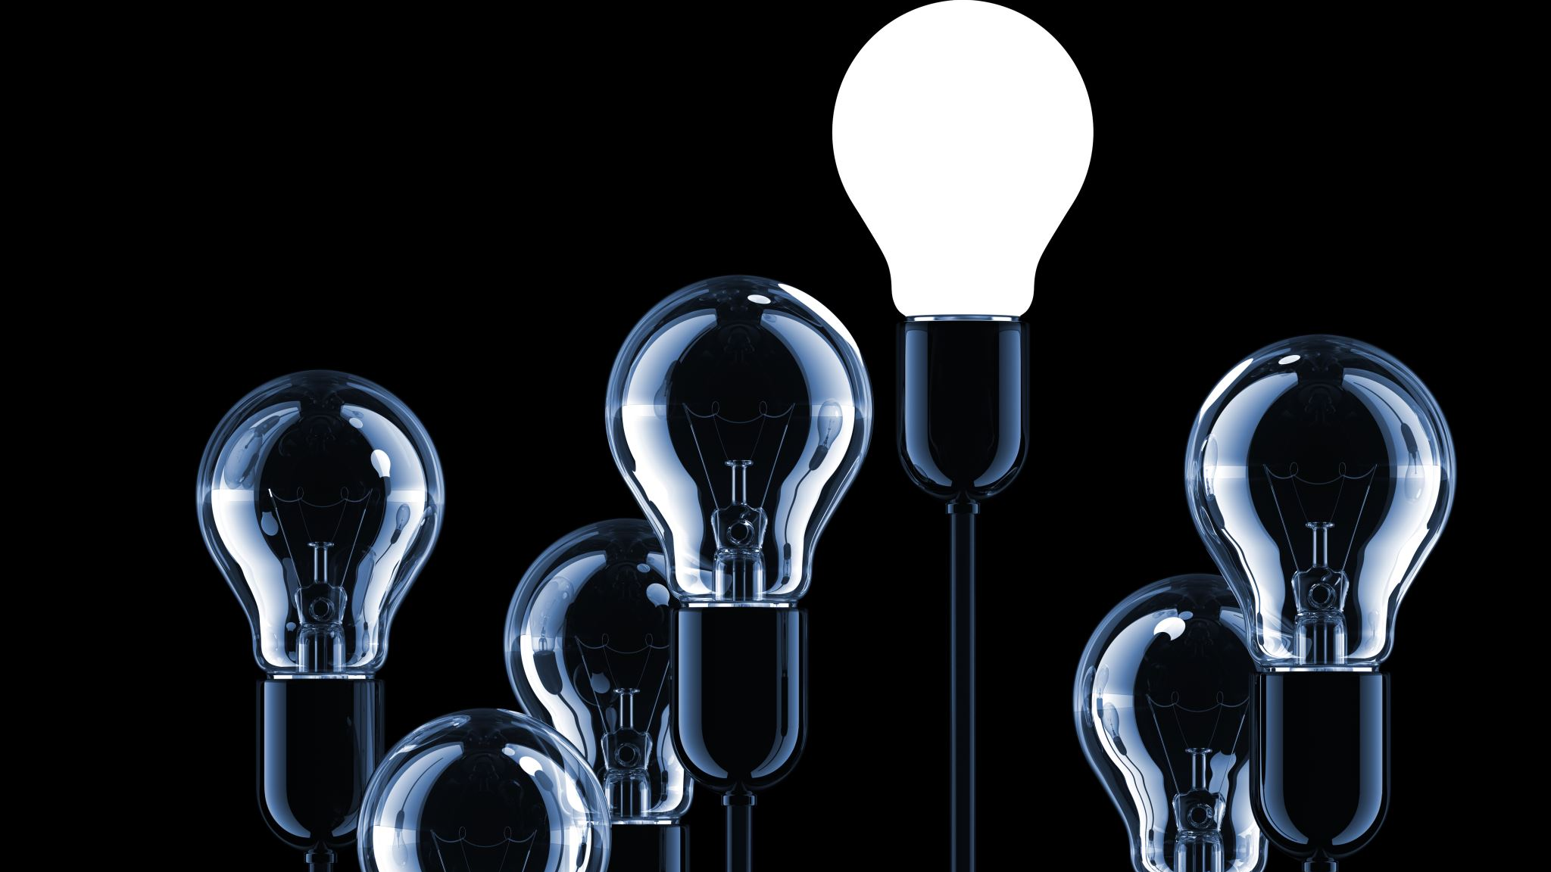
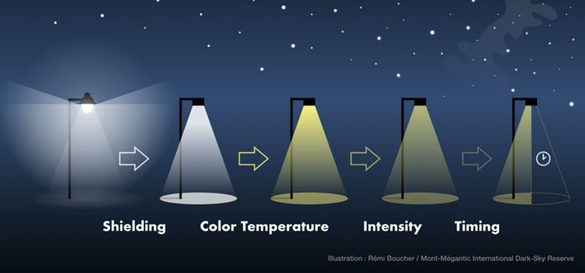
Simple Steps
Source: https://fishersisland.net/2022/04/north-fork-dark-sky-initiative-limiting-light-pollution/

Slide 6
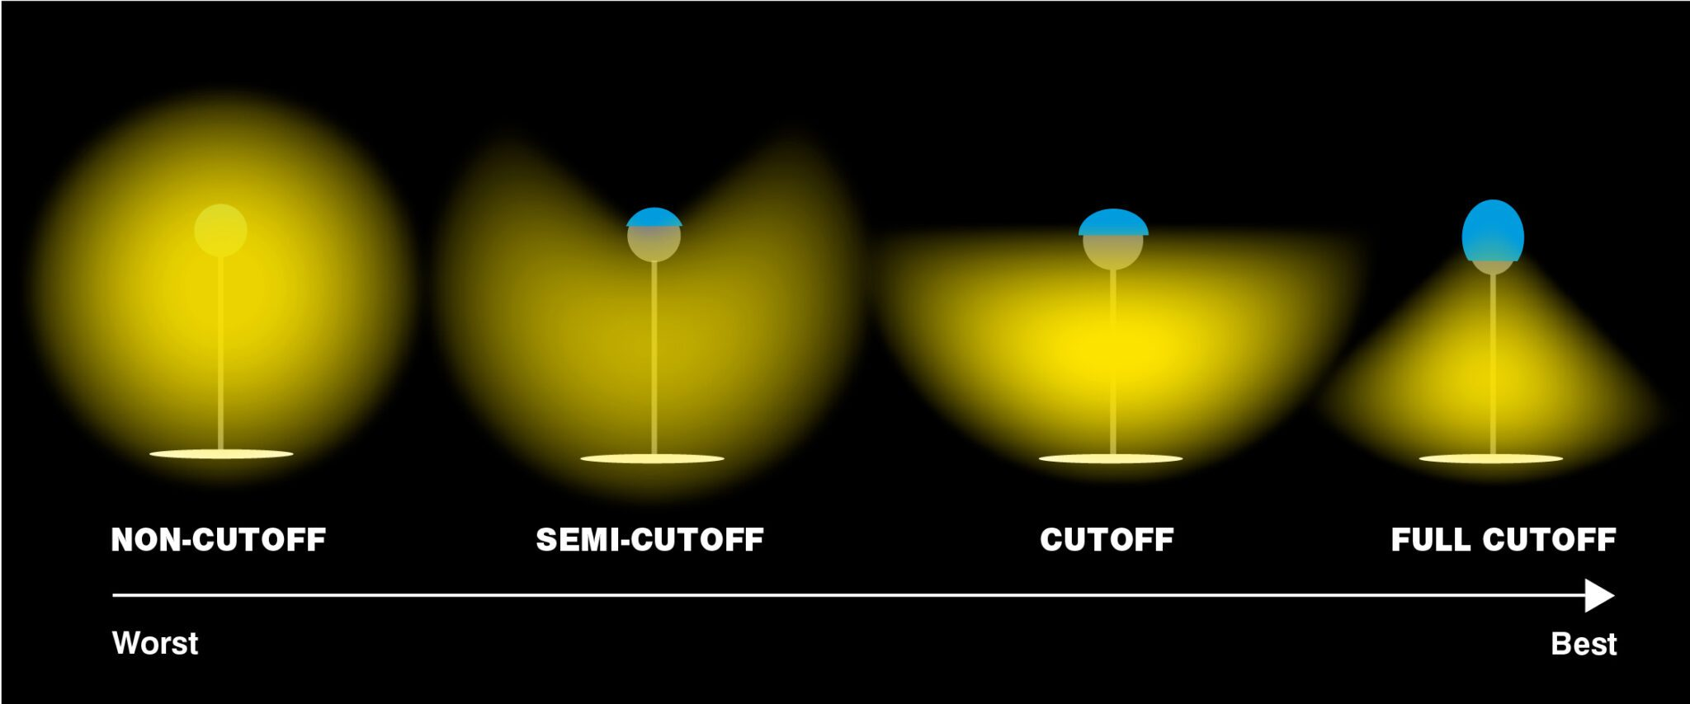
Shielding
Light from source should be directed downward and towards the areas and objects requiring illumination
Light should never be directed upward!
Source: https://solutions.borderstates.com/what-is-dark-sky-compliance/

Slide 7
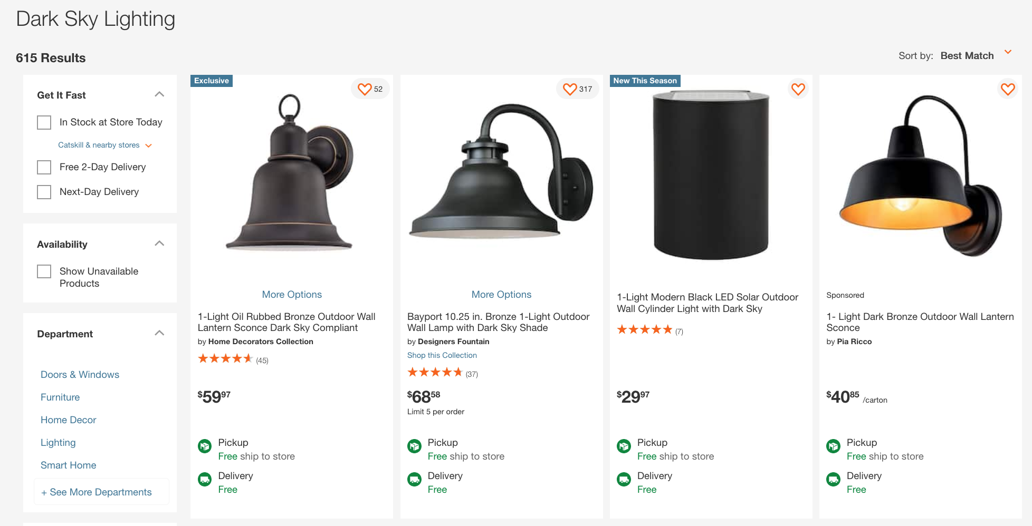
Dark Sky compliant lighting is readily available
Source: https://solutions.borderstates.com/what-is-dark-sky-compliance/
Notes:
We need to get Herrington’s to start stocking it!

Slide 8
Learn more:
Resources
www.darksky.org
https://www.nps.gov/articles/night-skies.htm
https://www.fws.gov/project/dark-skies-initiative#:~:text=Many%20species%20rely%20on%20natural,quality%20of%20the%20night%20sky.
https://www.fairfaxcounty.gov/environment-energy-coordination/climate-matters/dark-sky-lighting
Thanks to Bill Kish for content and for championing

